Slide 1

Global Climate change & its impacts on Pakistan
Dr. Bilal Ahmad Zafar Amin
PhD in Plant Production and Environment
University of Reims, France
Assistant professor
Energy Research Centre
COMSATS Institute of Information Technology
Lahore, Pakistan

Slide 2
Global Climate change & its impacts on Pakistan
CONTENTS
Climate, weather & climate change
Greenhouse effect & global warming
Why our earth is affected?
Impacts of global climate change
Actors to find solutions
Precautionary measures to be taken
Summary

Slide 3
Global Climate change & its impacts on Pakistan
Climate Change
Weather: Defines the tendency of the atmospheric changes over short periods of time
Temperature
Rainfall
Precipitation
Wind speed and direction
Climate: Defines the tendency of the weather over long periods of time
“Climate is what you expect
Weather is what you get”

Slide 4
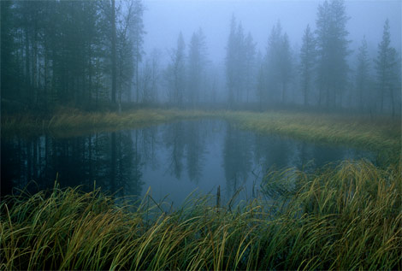
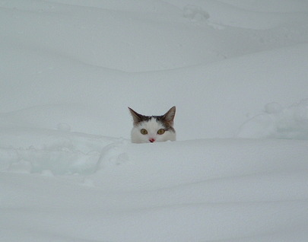
Global Climate change & its impacts on Pakistan
Climate Change
Climate is:
- Long term
- Large area
- Can change slowly
- Easy to predict
Weather is :
- Short term
- Limited area
- Can change rapidly
- Difficult to predict
WEATHER is what’s happening outside your window right now.

Slide 5
CLIMATE CHANGE/GLOBAL WARMING
The Green House Effect
Some gases naturally exist in the atmosphere, the so called Greenhouse Gases (GHGs) that form a blanket surrounding the earth and keeps the earth warmer. This is called Greenhouse Effect.
The Enhanced Greenhouse Effect
Human activities (fossil fuel burning, depletion of sinks like forests etc.) has been increasing the concentration of GHGs in the atmosphere and is leading to rise in temperatures. This is called Enhanced Greenhouse Effect.
Global Warming/Climate Change
Rise in temperatures of earth and other associated climatic changes as caused by the Enhanced Green House Effect is called “Global Warming” and in broader term “Climate Change”.

Slide 6
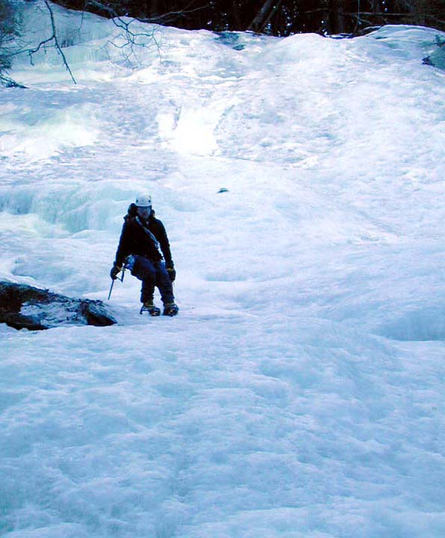
Global Climate change & its impacts on Pakistan
With no greenhouse gases at all in its atmosphere, scientists estimate that Earth’s average atmospheric temperature would be about -18° C, or about 0°F

Slide 7
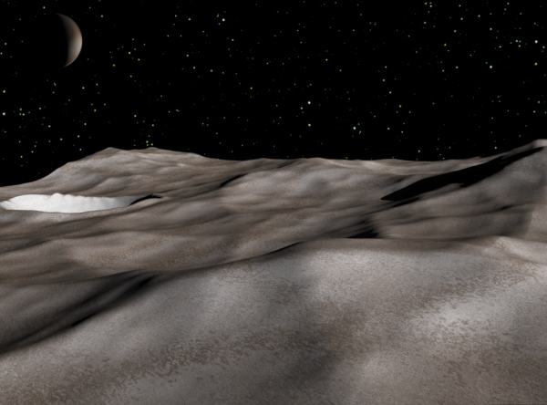
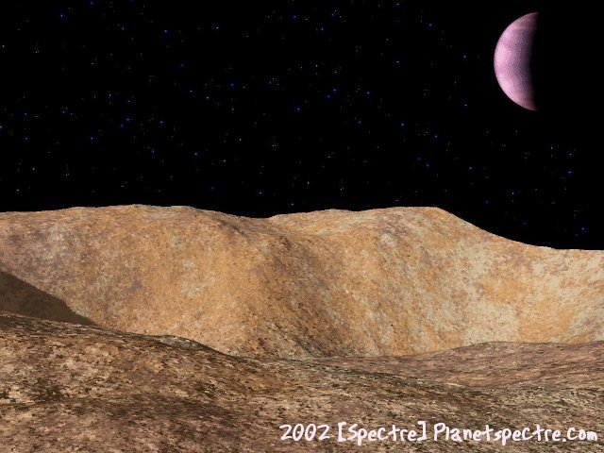
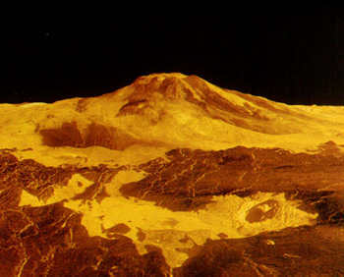
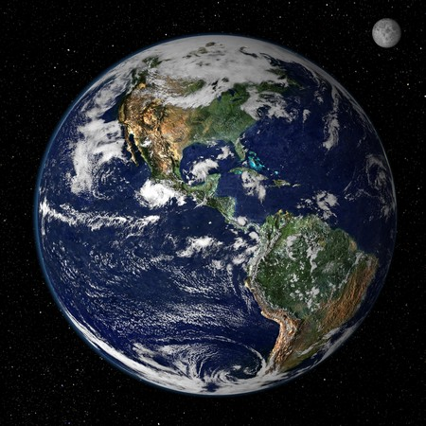
Global Climate change & its impacts on Pakistan
Climate Change and Green house gases
…or they have huge temperature swings from day to night.
Planets with very little greenhouse effect are either very cold…
Pluto’s average temperature is –370° F
On Mars, there is about a 300 degree F difference between high and low temperatures
Planets with abundant greenhouse gases are very hot
…and then there’s Earth….
Which is just right…for the moment, anyway.
The average temperature on Venus is about 855° F!

Slide 8
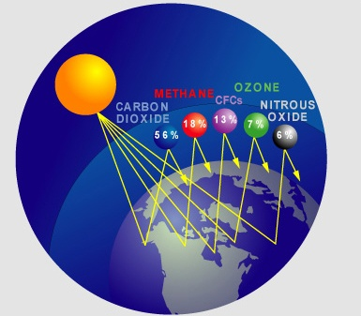
COMPOSITION OF GREENHOUSE GASES
Gases in our atmosphere which absorb IR waves and radiate some of the heat back toward the earth.
Methane
Nitrous oxide
Chlorofluorocarbons
Carbon dioxide (CO₂)

Slide 9
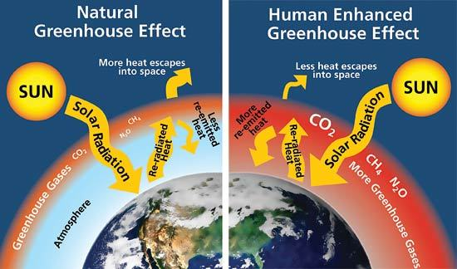

Slide 10
Greenhouse Effect
The Greenhouse Effect plays a crucial role in maintaining a life-sustaining environment on the Earth;
If there was no Greenhouse Effect, the average temperature of the Earth would have been -18ºC (253°K) instead of the present 15ºC;
Human activity is enhancing the natural Greenhouse Effect by adding gases like carbon dioxide, methane, nitrous oxide, chlorofluorocarbons, ozone, etc;
It is this Enhanced Greenhouse Effect which is causing Global Warming and Climate Change.

Slide 11
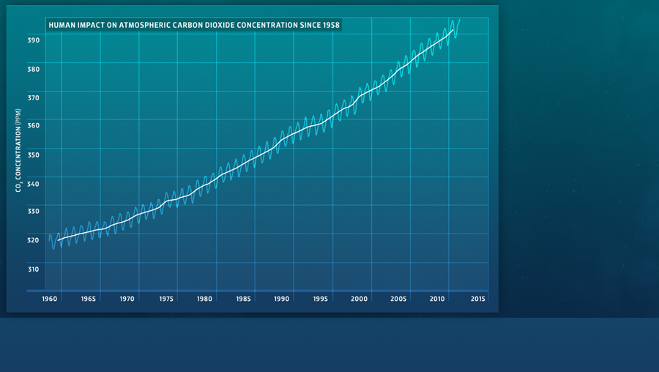
Global Climate change & its impacts on Pakistan
Climate Change

Slide 12


Climate Change
Natural + Anthropogenic
CLIMATE CHANGE
Global Warming
Increased Precipitation & its uneven Distribution
Melting of Glaciers & Snow
Sea level Rise
Increase in Frequency & Intensity of Extreme Weather Events
IMPACTS
Uncertainty in Water
Availability
Decrease in Crop Yields
Loss of Biodiversity
Increase Health Risks
Natural Climate
Variability
Anthropogenic Influences since the Industrial revolution
Spiraling Population
High pace of Industrialization
Increasing use of Fossil Fuels in Industry & Transport
Deforestation for Agriculture and Urbanization

Slide 13
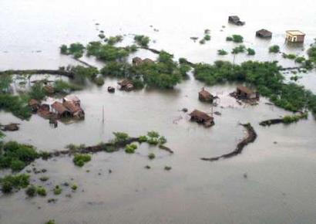
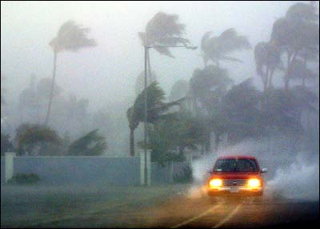
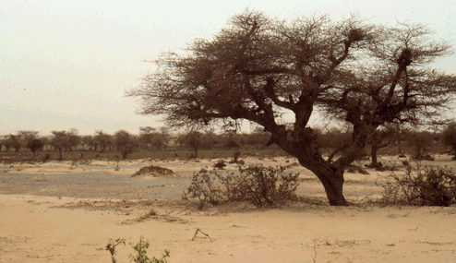
Increased frequency of weather extremes:
Global Warming
Increased Precipitation & its uneven Distribution
Increase in Frequency & Intensity of Extreme Weather Events
Melting of Glaciers & Snow
Sea level Rise
Higher water demand due to higher temperatures
Sea level rise: Loss of fertile land, seawater intrusion
Floods
Natural Climate
Variability
Climate Change
Natural + Anthropogenic
Storms
Anthropogenic Influences since the Industrial revolution
Droughts

Slide 14
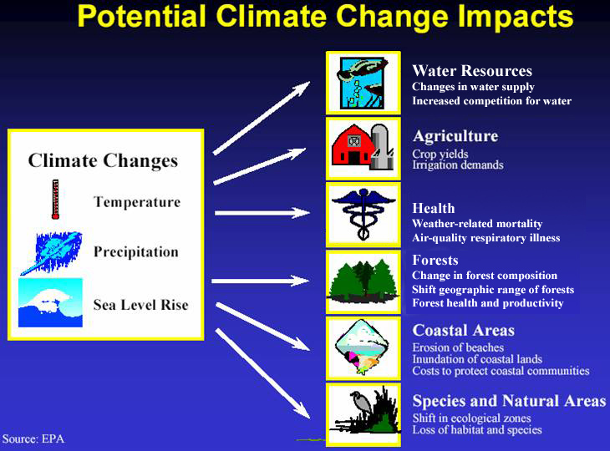

Slide 15
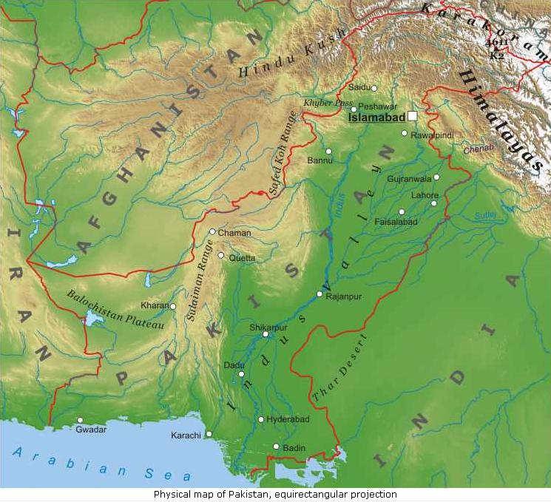
Global Climate change & its impacts on Pakistan
Climate Change
The country has a long latitudinal extent stretching from the Arabian Sea in the south to the Himalayan mountains in north
It is located in sub-tropics and partially in temperate region
Most Parts of Pakistan are Arid to Semi Arid with significant spatial and temporal variability in climatic parameters
59% Annual Rainfall is due to summer monsoons
Greater Himalayan region above 35º N receives winter precipitation mostly in the form of snow and ice.

Slide 16
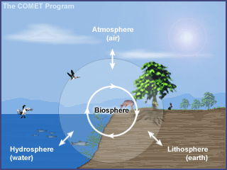
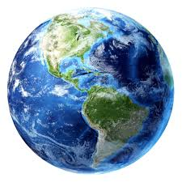
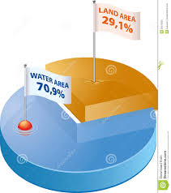
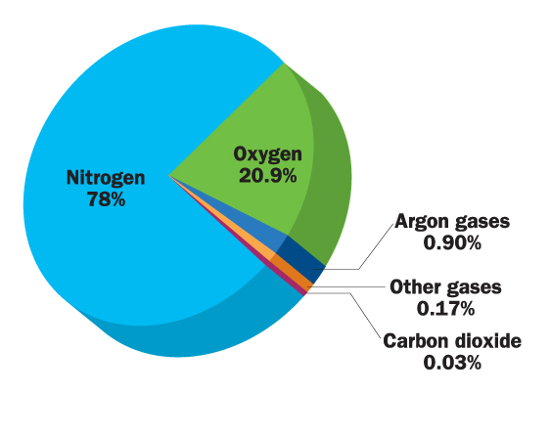
Global Climate change & its impacts on Pakistan
4
Spheres
Lithosphere
Hydrosphere
Atmosphere
Human
Animal
Plants
Anthropogenic activities

Slide 17
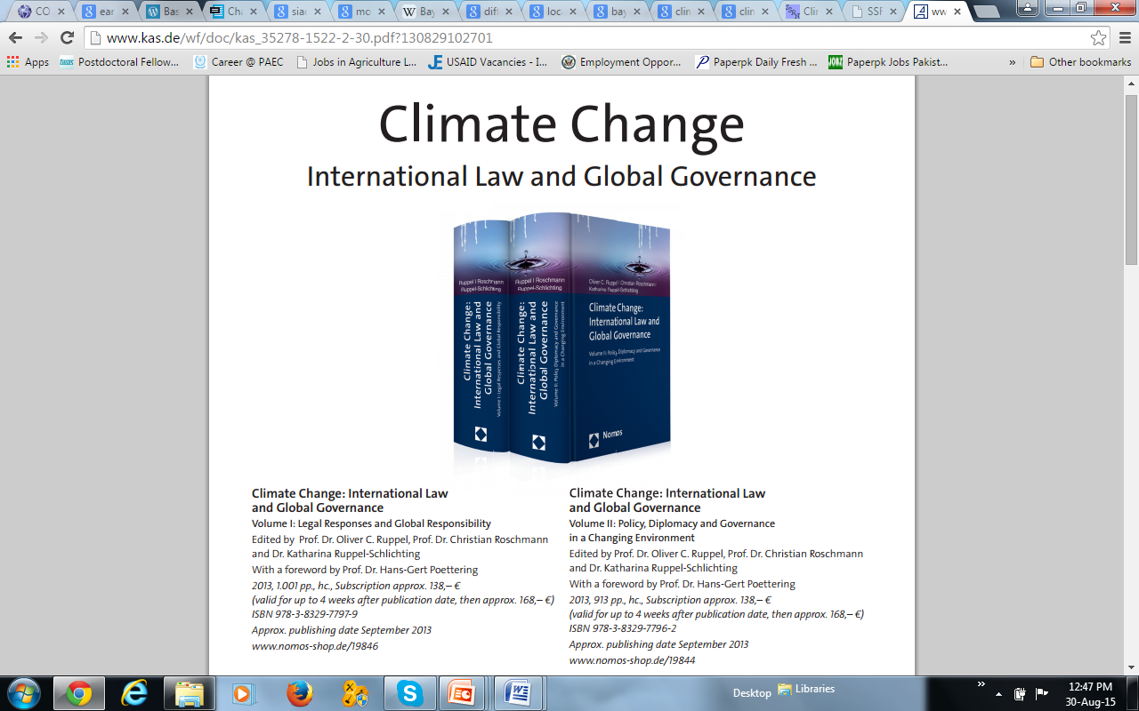
Volume I:
assesses the most pressing impacts of climate change on various international law regimes
■ climate change, the law of the sea and sea level rise ■ judicial review and international climate change litigation
Volume II:
reflects on the United Nations Framework Convention on Climate Change (UNFCCC) and the most pressing impacts of climate change on ■ international diplomacy and ■ global governance.

Slide 18
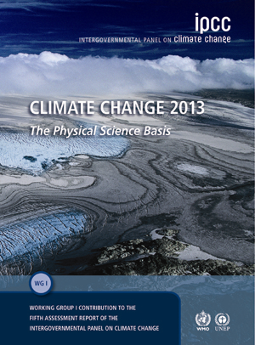

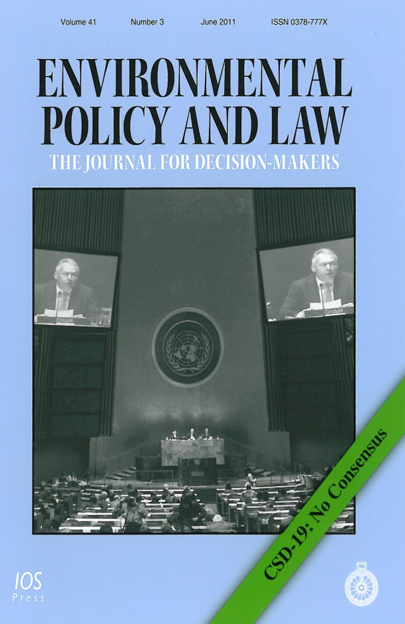
Some other authentic books……..

